Slide 1
Basic Understanding of MOQ Framework
Anil. Y

Slide 2
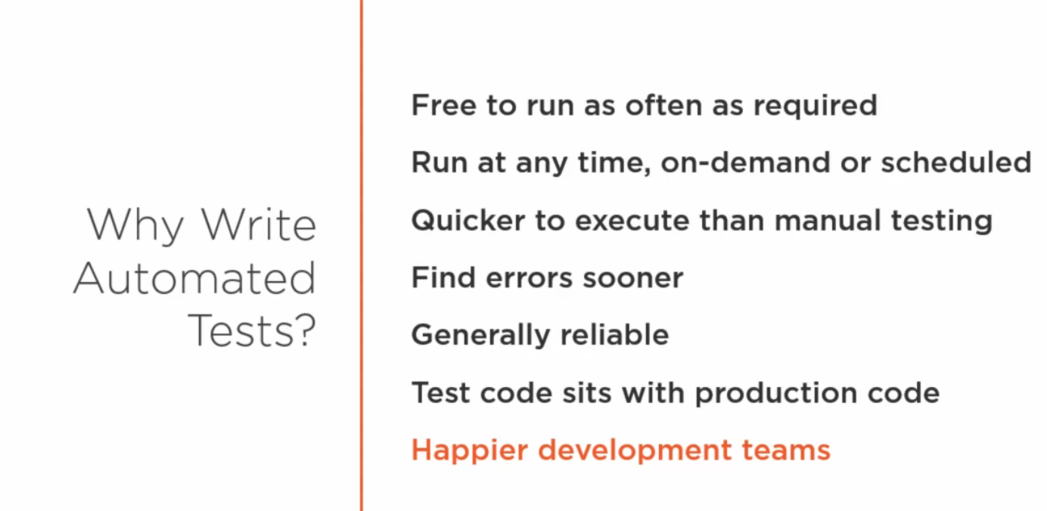

Slide 3
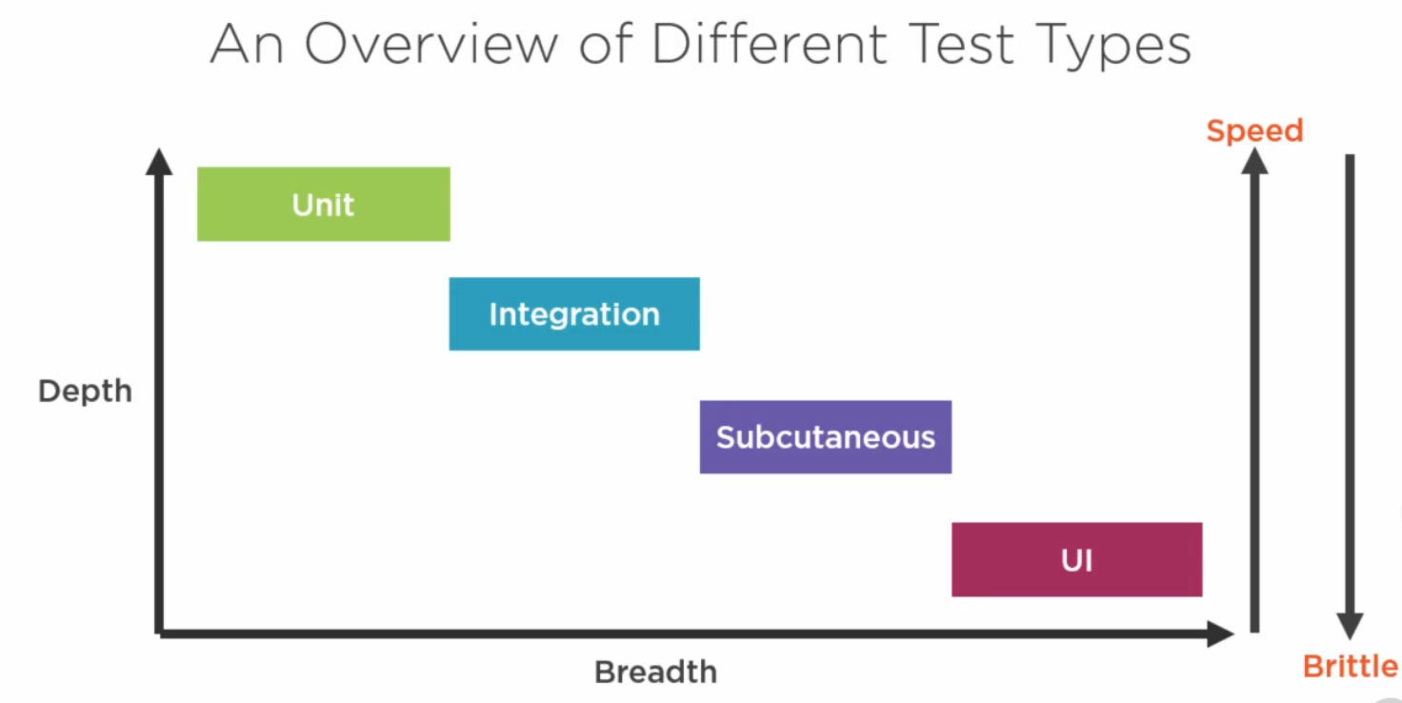

Slide 4
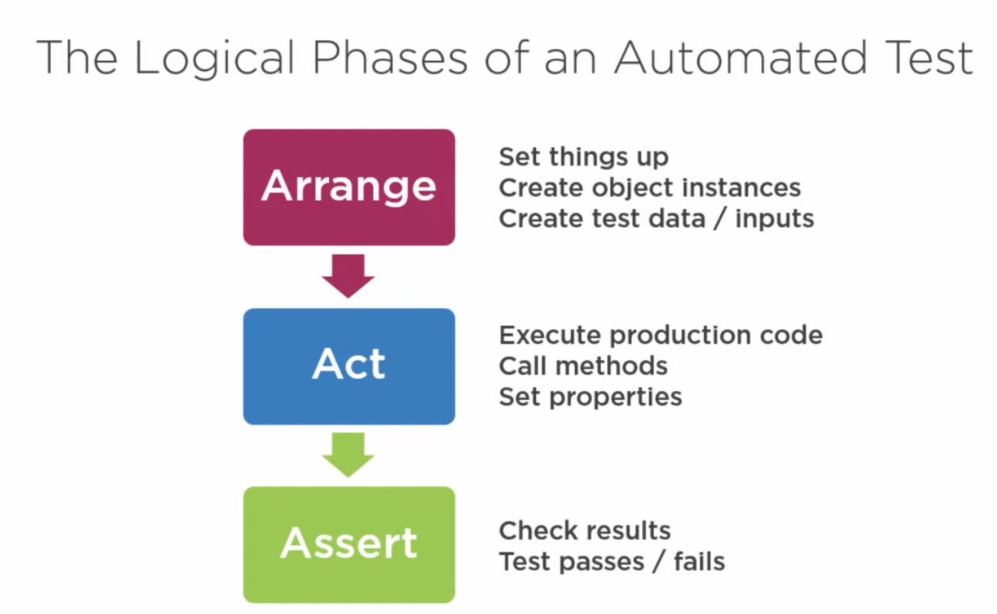

Slide 5
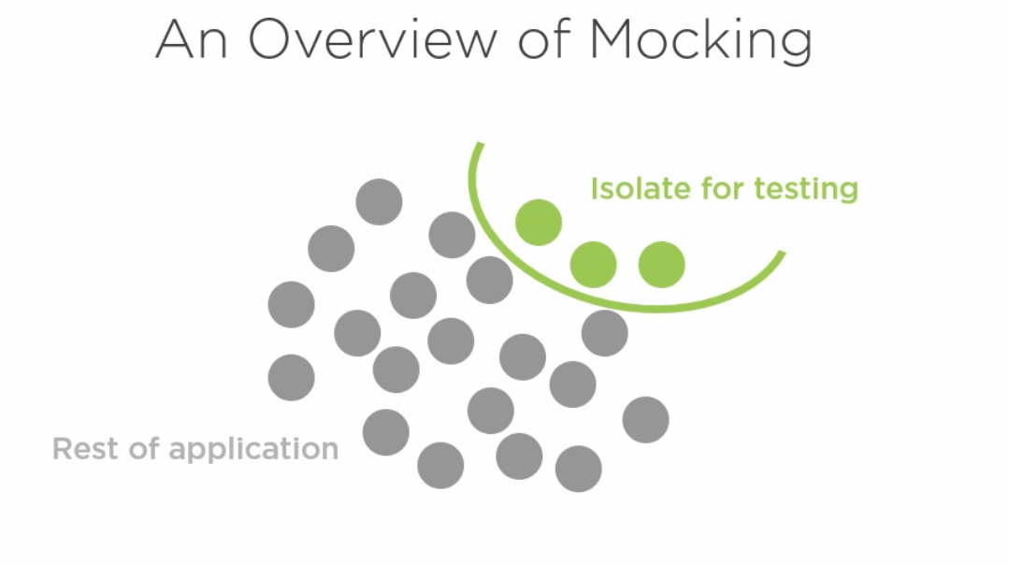
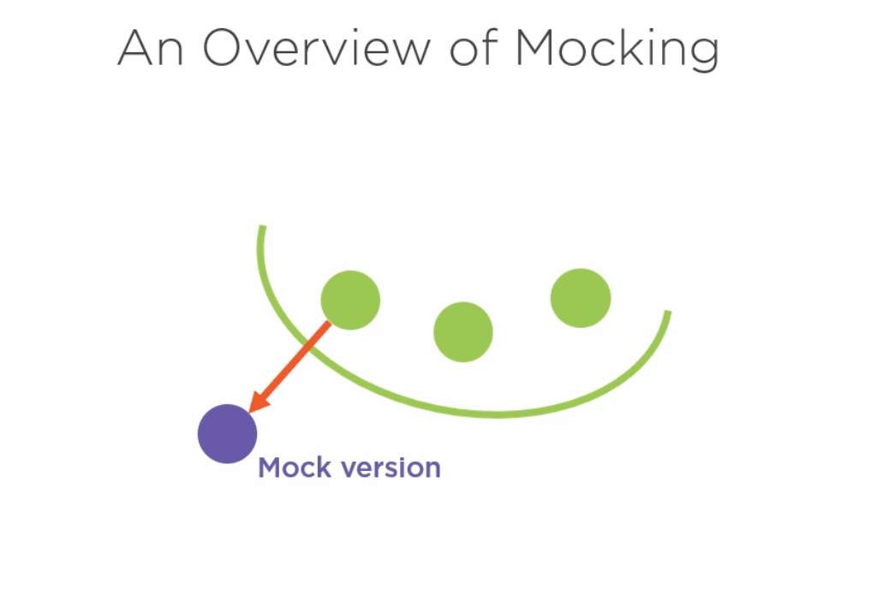
Why MOQ?

Slide 6
DEMO

Slide 7
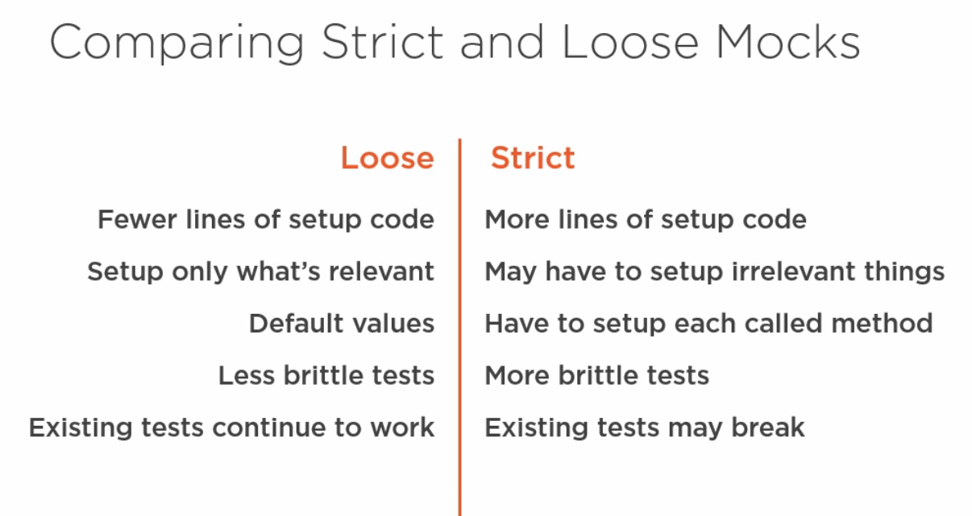

Slide 8
Thank You ☺

